Slide 1
Sewer system Presentation
Date: March 9, 2022

Slide 2
Meeting overview
Principles
Sewer system review
Flow estimates
Next steps
Council input

Slide 3
principles
Operate the plant and system in a responsible, legal, efficient manner
Ensure sufficient capacity to support Borough development
Charge users based on flows, capital needs, and liability

Slide 4
Sewer System Review: basic Terms
EDU
Tapping fee
Sewer rental fee
Treatment capacity
Conveyance capacity
Infiltration and inflow (I/I)
Hydraulic & organic loading

Slide 5
Sewer System Review: FAQ’s
Is the Township flowing 580,000 gallons per day and, if not, how much?
Is portable meter data accurate and, if not, why?
How is sewer billed, what is the rate, and is it different for Borough vs. Township?
Is every sewer connection metered and, if not, why?
How are higher-than-expected flows billed?
Who is responsible for repairs to the existing plant and system?
Who is responsible for costs to expand the plant and system for new connections?
What is infiltration and inflow, how is it measured, and why does it matter?

Slide 6
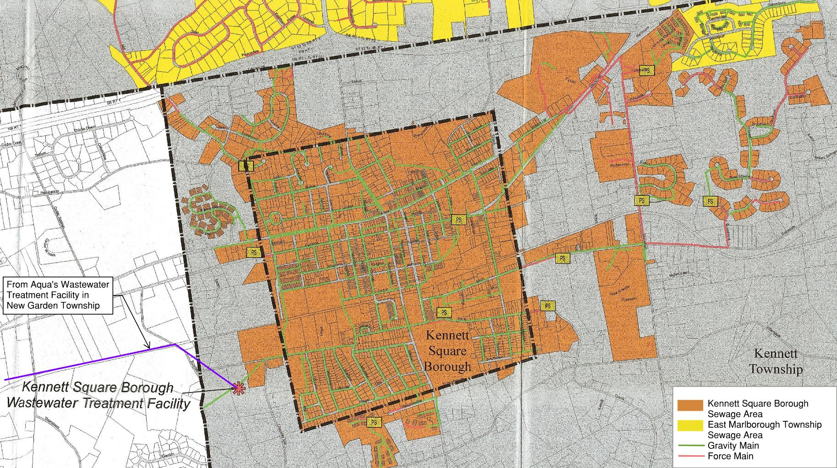
Regional service map

Slide 7
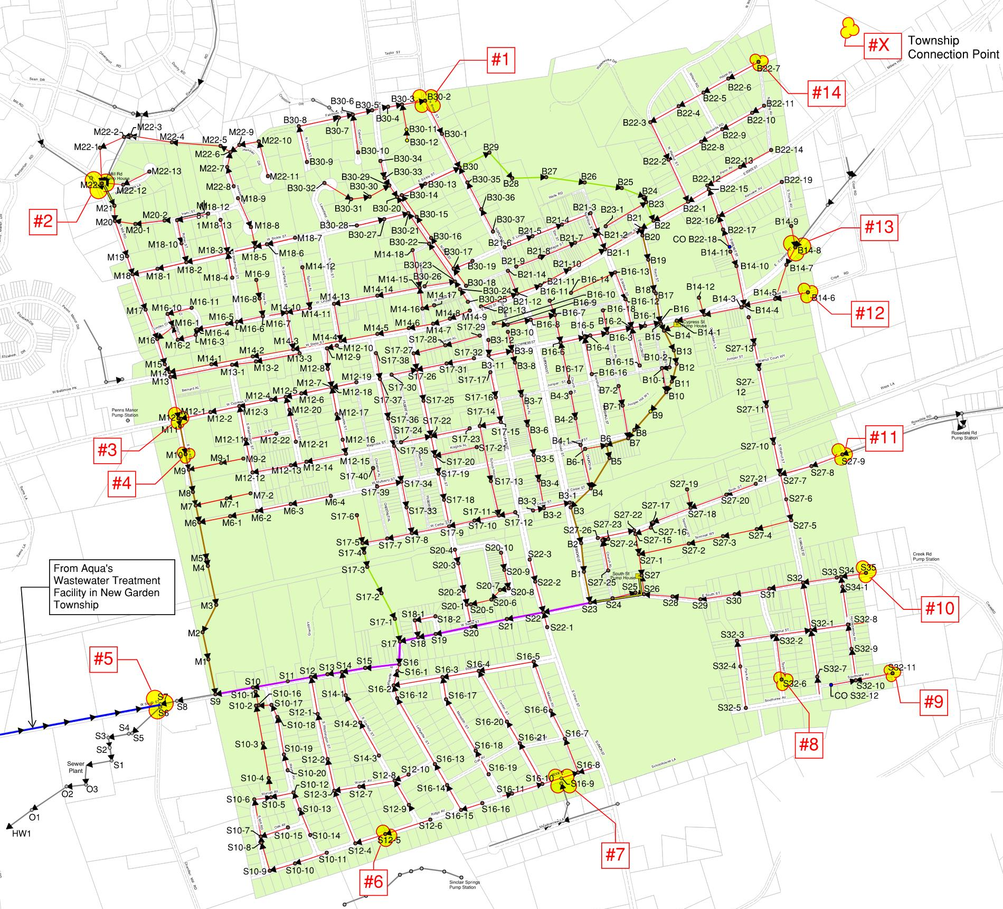
borough service map

Slide 8
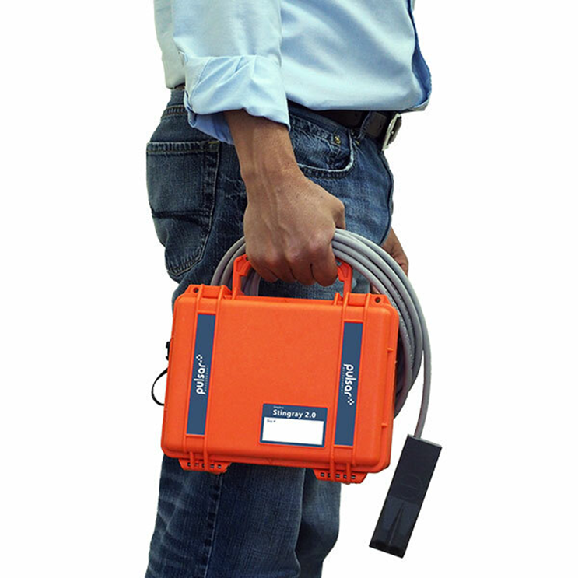
Flow Estimates
Challenges of temporary metering
Instrumentation issues
Limits of accuracy of portable meters (installation location,
data measurements rather than flow measurements (cfs and height)
Impact of solids in the temp meter sensors
Impact of sewer water flow turbulence
More of a comparative measuring device rather than actual flows)
Comparison to known data – inconsistency of water consumption
flow comparisons

Slide 9
Flow estimates
 | Estimated 2021 Existing Flow (GPD) | 5-Year Projected Flow (GPD) | >5-Year Projected Flow(GPD)
Kennett Square Borough | 395,000 | 582,000 | 582,000
Kennett Township | 273,000 (est.) | 357,000 ² | 391,000 ²
Aqua/New Garden Township | 64,000 ³ | 100,000 | 100,000
Hauled-in Wastewater | 5,000 | 5,000 | 5,000
TOTAL¹ | 737,000 | 990,000 | 1,078,000⁴
^{1.} Wastewater Treatment Plant Capacity = 1.1 MGD⁴
^{2.} Kennett Township Intermunicipal Capacity = 318,500 GPD
^{3.} 2020 actual flow data since 2021 data is under analysis at the time of this presentation. 2021 flows are expected to be greater than 2020.
^{4.} Do we need to expand the plant? Note the impact of individual peak flows on capacity (and the need for buffer between average flows and overall capacity). Need to be able to handle the peaks. Organic loading vs. hydraulic loading. Best practice – start planning at 80%.
FAQ: What portion of Borough capacity is currently being used and where would we be with build out of NVF? What are the Borough’s future needs?

Slide 10
Next Steps: improve Data & billing accuracy
Install permanent gravity meters
KSB and KT pump station meters and EDU estimates
KSB and KT customer water consumption metering analysis (where perm meters not feasible/possible)
Bill based on higher-than-expected use

Slide 11
Next Steps: adopt Contract Amendment
Existing Agreement and Proposed Amendment
What does it say as to Township flows?
What issues/concerns are there with the agreement and how it has been implemented?
Reporting of new connections
Pump station maintenance costs
Costs for plant/system upgrades
Permanent metering & accurately measuring flows
Consideration of immediate projects on the horizon
Addressing infiltration and inflow within/between the systems

Slide 12
Next Steps: Maintain Capital & expand capacity
Install permanent flow meters
Fund inflow and infiltration (I&I) study
Complete GIS-based sewer hydraulic model
Complete chapter 94 report and Act 537 planning for long-term needs
Upgrade south street pump station and gravity sewers
Upgrade western south street gravity sewer
Upgrade terminal way
Upgrade eastern south street gravity sewer
Replace south street pump station

Slide 13
Council input
Is there Council consensus for the following?
Principles
Contract amendments

